Slide 1

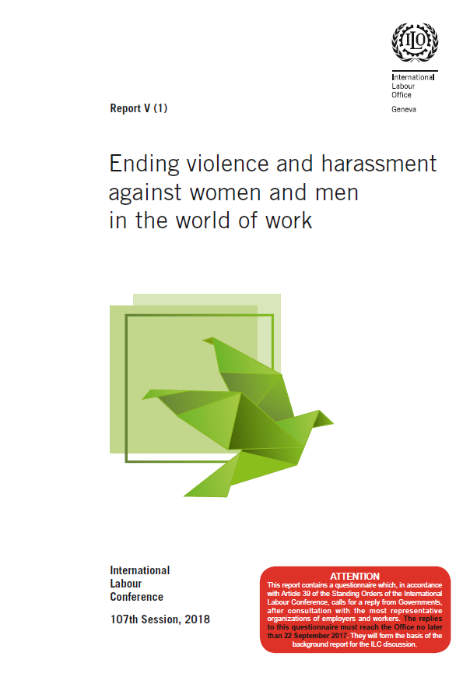
Workplace approaches to addressing domestic violence
  Highlights of ongoing process towards a new standard on violence and harassment in the world of work
Manuela Tomei
Conditions of Work and Equality Department
International Labour Office (ILO)

Slide 2
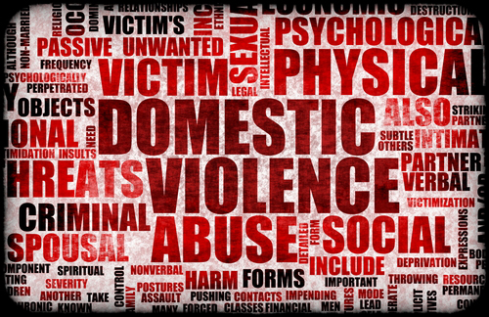
The domestic violence and GBV at work nexus
Domestic violence may occur at the workplace or while the victim is at the workplace
  Murder at the workplace, sometimes involving partner perpetrators, is amongst the top cause of death for women in the US.
Domestic violence can undermine a woman’s ability to get to work, to stay at work, to work well, and influences the type of jobs she may be able to engage in
Domestic violence can also have repercussions for the safety of co-workers and clients/patients
Work-related violence can also spill over the home- men in male-dominated sectors or where violence is “normal” are more likely to be violent towards their partners
Notes:
in- absenteeism, turnover, underperformance

Slide 3

Domestic violence as a world-of-work issue
Gender-based violence (GBV) at work and domestic violence are two faces of the same coin
If a woman can be helped to keep her job, it can help her escape a violent family relationship
Framing domestic violence as a world-of-work issue extends the reach of the employment relationship
Notes:
«Domestic» or «family» violence those in a traditionally understood family relationship such as those related through blood or mariage or intimate partners. It is cokmmonly understoodto include physical, sexual, psychological and , increasingly, «economic violence», e.g. retention or partial or total destruction of the vctim’s working tools is regrdaedc as form of domestic violence

Slide 4
Towards (a) new international labour standard(s) on violence and harassment in the world of work: Why?
After several years of discussion, the ILO Governing Body placed a standard-setting item on “violence against women and men in the world of work” on the ILC agenda for a double discussion procedure, beginning in 2018.
A Tripartite Meeting of Experts (TME) was held in Geneva (3-6 October 2016) to inform the GB’s decision regarding preparations for the first discussion of (a) possible instrument(s) by the ILC.
http://www.ilo.org/wcmsp5/groups/public/---ed_norm/---relconf/documents/meetingdocument/wcms_533534.pdf

Slide 5


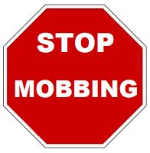

Towards (a) new international labour standard(s) on violence and harassment in the world of work: Why?
Regulatory gaps in national legislation
«Workplace» in many labour laws is defined too narrowly.
Workers who have the most exposure to workplace violence are the least or not protected at all
Lack of coherence and coordination between different types of legislation dealing with, or having bearings for, violence at work.
A criminal justice approach to addressing workplace violence is not effective in dealing with more insidious forms of violence such as sexual harassment and bullying.
Employers’ general duty to protect the health and safety of workers in most countries exclude violence at work.
Only a small number of countries consider the health consequences of workplace violence as compensable occupational illnesses.
Need for a gender lens to regulatory protections.
Background paper for discussion at the Meeting of Experts on Violence against Women and Men in the World of Work, Meeting of Experts on Violence against Women and Men in the World of Work, Geneva, 3-6 October 2016 http://www.ilo.org/wcmsp5/groups/public/---dgreports/---gender/documents/meetingdocument/wcms_522932.pdf

Slide 6



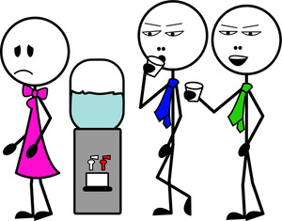
Towards (a) new international labour standard(s) on violence and harassment in the world of work: Why?
Regulatory gaps in ILO international labour instruments (ILS)
No dedicated ILS which defines violence(s) and provides scope for it.
A number of ILS address violence against certain groups, as part of broader protection approaches (e.g. C169 and C189, and R200)
A number of ILS, while not mentioning violence explicitly, provide useful elements for addressing it (e.g. C155 and C187, and C102 and C120)
No ILS provide for an approach bringing prevention, protection, and compensation and rehabilitation together
Background paper for discussion at the Meeting of Experts on Violence against Women and Men in the World of Work, Meeting of Experts on Violence against Women and Men in the World of Work, Geneva, 3-6 October 2016 http://www.ilo.org/wcmsp5/groups/public/---dgreports/---gender/documents/meetingdocument/wcms_522932.pdf

Slide 7
Understanding what is «violence» in «the world of work»
(Conclusions adopted by the TME, October 6-8 October 2016) http://www.ilo.org/wcmsp5/groups/public/---ed_norm/---relconf/documents/meetingdocument/wcms_533534.pdf
“Violence and harassment” in lieu of “violence” only.
“Violence and harassment” are likely to result in physical, psychological or sexual harm or suffering. A particular focus needs to be placed on GBV.
“The world of work” covers not only the traditional physical workplace, but also commuting to and from work, work-related social events, public spaces and the home when home is the workplace.
Domestic violence and other forms of violence are relevant to the world of work when they impact the workplace.

Slide 8
Risk factors for violence in the world of work
Conclusions adopted by the TME, October 6-8 October 2016) http://www.ilo.org/wcmsp5/groups/public/---ed_norm/---relconf/documents/meetingdocument/wcms_533534.pdf
Violence in the world of work often reflects wider societal violence and imbalances in power.
Violence can affect everyone, but affects specific groups disproportionately, where certain conditions exist
Risk factors/conditions include. Among others, working in isolation in private homes or in contact with the public or in work arrangements that are not adequately covered by labor law or social protection, etc..
Notes:
Exposure to V+H is highly contextual and results from a converge of factors, discrimination, conditions. It is important not to reduce the analysis to who «is the most vulnerable» to V+H, as this could mistankenly imply that who people are or what they do make them victims

Slide 9
Addressing violence in the world of work
(Conclusions adopted by the TME, October 6-8 October 2016) http://www.ilo.org/wcmsp5/groups/public/---ed_norm/---relconf/documents/meetingdocument/wcms_533534.pdf
«Governments, employers and workers have a role in ensuring compliance with law and policy, as well as in adopting proactive initiatives.»
«Prevention and support are key components to addressing violence and harassment.»
«Collective agreements could address the effects of domestic violence.»
“There is a need for more and better data on the nature and extent of violence and harassment in the world of work, and the Office is invited to assist in developing a methodology to improve comparability of data.”

Slide 10
How national legislation on domestic violence deals with work-related violence
Note: The sample for this figure consists of 78 countries: 20 countries from Africa; 14 from the Americas; four from the Arab States; 15 from Asia and the Pacific; and 25 from Europe and Central Asia.
Source: ILO 80-country study on the law and practice addressing violence and harassment against women and men in the world of work.
Ending violence and harassment against women and men in the world of work, Report V(1), International Labour Conference, 107th Session, 2018
http://www.ilo.org/wcmsp5/groups/public/---ed_norm/---relconf/documents/meetingdocument/wcms_553577.pdf

Slide 11
“Economic violence” as integral to the legal definition of “domestic violence”, by region
Note: The sample for this figure consists of 78 countries: 20 countries from Africa; 14 from the Americas; four from the Arab States; 15 from Asia and the Pacific; and 25 from Europe and Central Asia.
Source: ILO 80-country study on the law and practice addressing violence and harassment against women and men in the world of work.
Ending violence and harassment against women and men in the world of work, Report V(1), International Labour Conference, 107th Session, 2018
http://www.ilo.org/wcmsp5/groups/public/---ed_norm/---relconf/documents/meetingdocument/wcms_553577.pdf

Slide 12
The role of workplace institutions actors in relation to domestic violence: The role of law
Employers must solicit a protection order for employees who have been victim of domestic violence (e.g. Puerto Rico, Zimbabwe, Kenya)
When the perpetrator and the target of domestic violence work in the same place, employers must adopt specific protection measures (e.g. Chile)
Employers can denounce and request protection orders in favour of employees who are subject to intimate partner’s violence (e.g. Namibia)
Judges can mandate employers not to interrupt the employment relationship with an employee who has taken leave of absence, due to domestic violence, during the first six months of leave (e.g. Brazil)
Ending violence and harassment against women and men in the world of work, Report V(1), International Labour Conference, 107th Session, 2018
http://www.ilo.org/wcmsp5/groups/public/---ed_norm/---relconf/documents/meetingdocument/wcms_553577.pdf

Slide 13
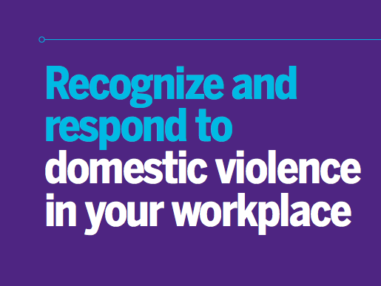
The role of workplace actors in relation to domestic violence
Workplaces can support women victims of domestic violence - whether violence occurs in or outside of the workplace
  Ensure women’s safety while at work
  Secure continued employment of women victims of intimate partners’ violence

Slide 14
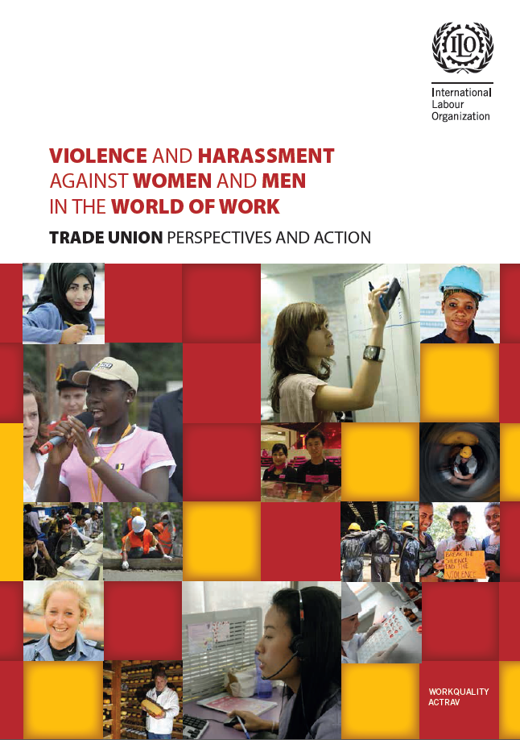
The role of workplace institutions actors in relation to domestic violence: The role of workplace negotiations and cooperation
Negotiating skills for sectoral and workplace policies on domestic violence at work
Model clauses that can form the basis for negotiating agreements.
Inclusion of prevention of domestic violence in workplace risk assessments and on the agendas of OSH committees.
Develop indicators of domestic violence as a workplace issue, e.g. changing jobs, changing locations, not attending social events, directing women to specialist support services.
Violence and harassment against women and men in the world of work: Trade union perspectives and action, International Labour Organization, 2017
http://www.ilo.org/actrav/info/pubs/WCMS_546645/lang--en/index.htm

Slide 15
Main milestones of the process towards (a) new international labour standard(s) on violence and harassment in the world of work
Release of law and practice report- cum- questionnaire to tripartite constituents in all ILO’s member States (May 2017); deadline for submission of answers is 22 September 2017
Synthesis report and first draft instruments (April 2018)
1st ILC discussion in 2018
Blue report
2nd ILC discussion in 2019 or 2020

